Slide 1


Slide 2


Slide 3


Slide 4


Slide 5
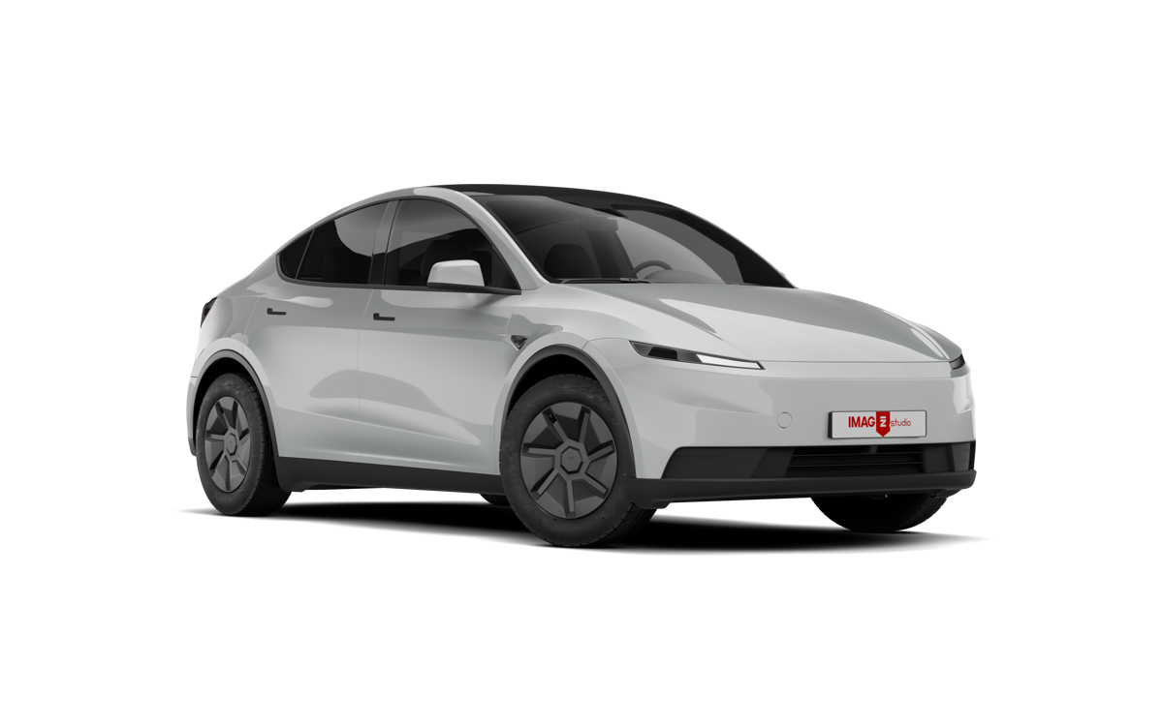
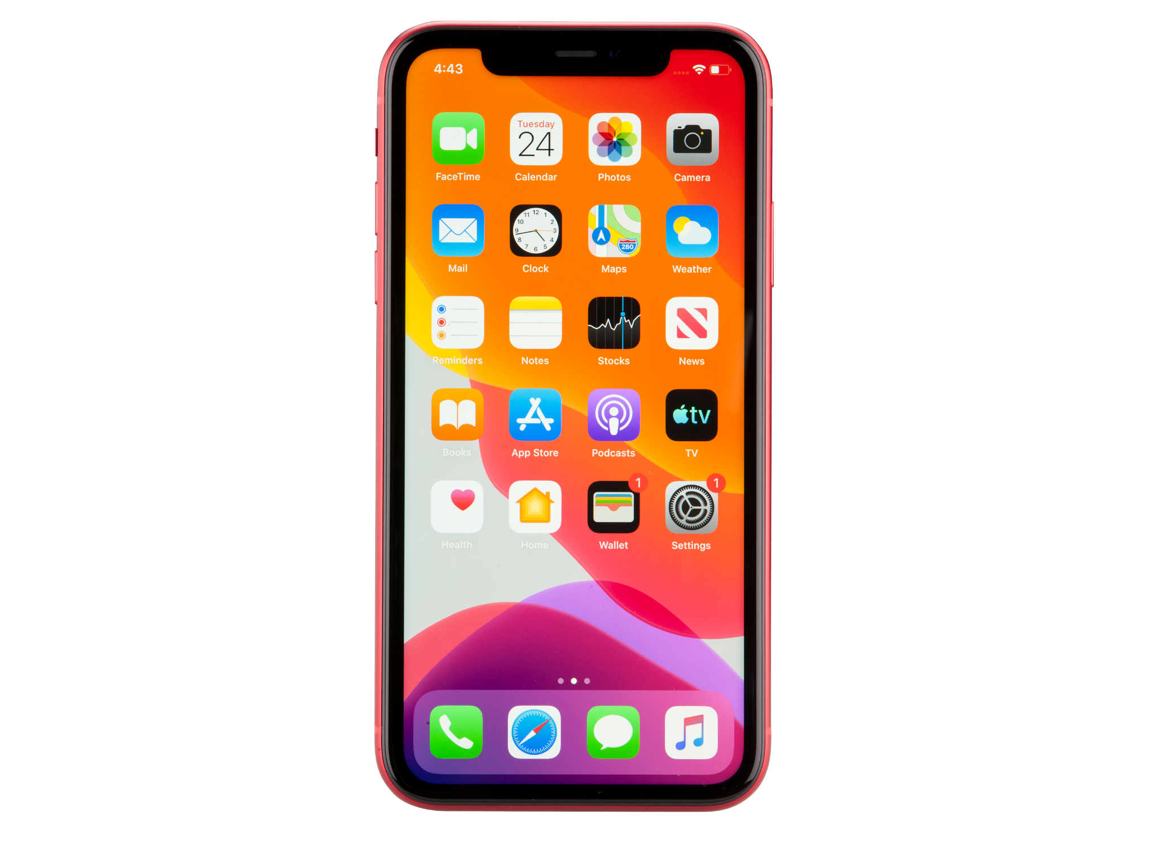

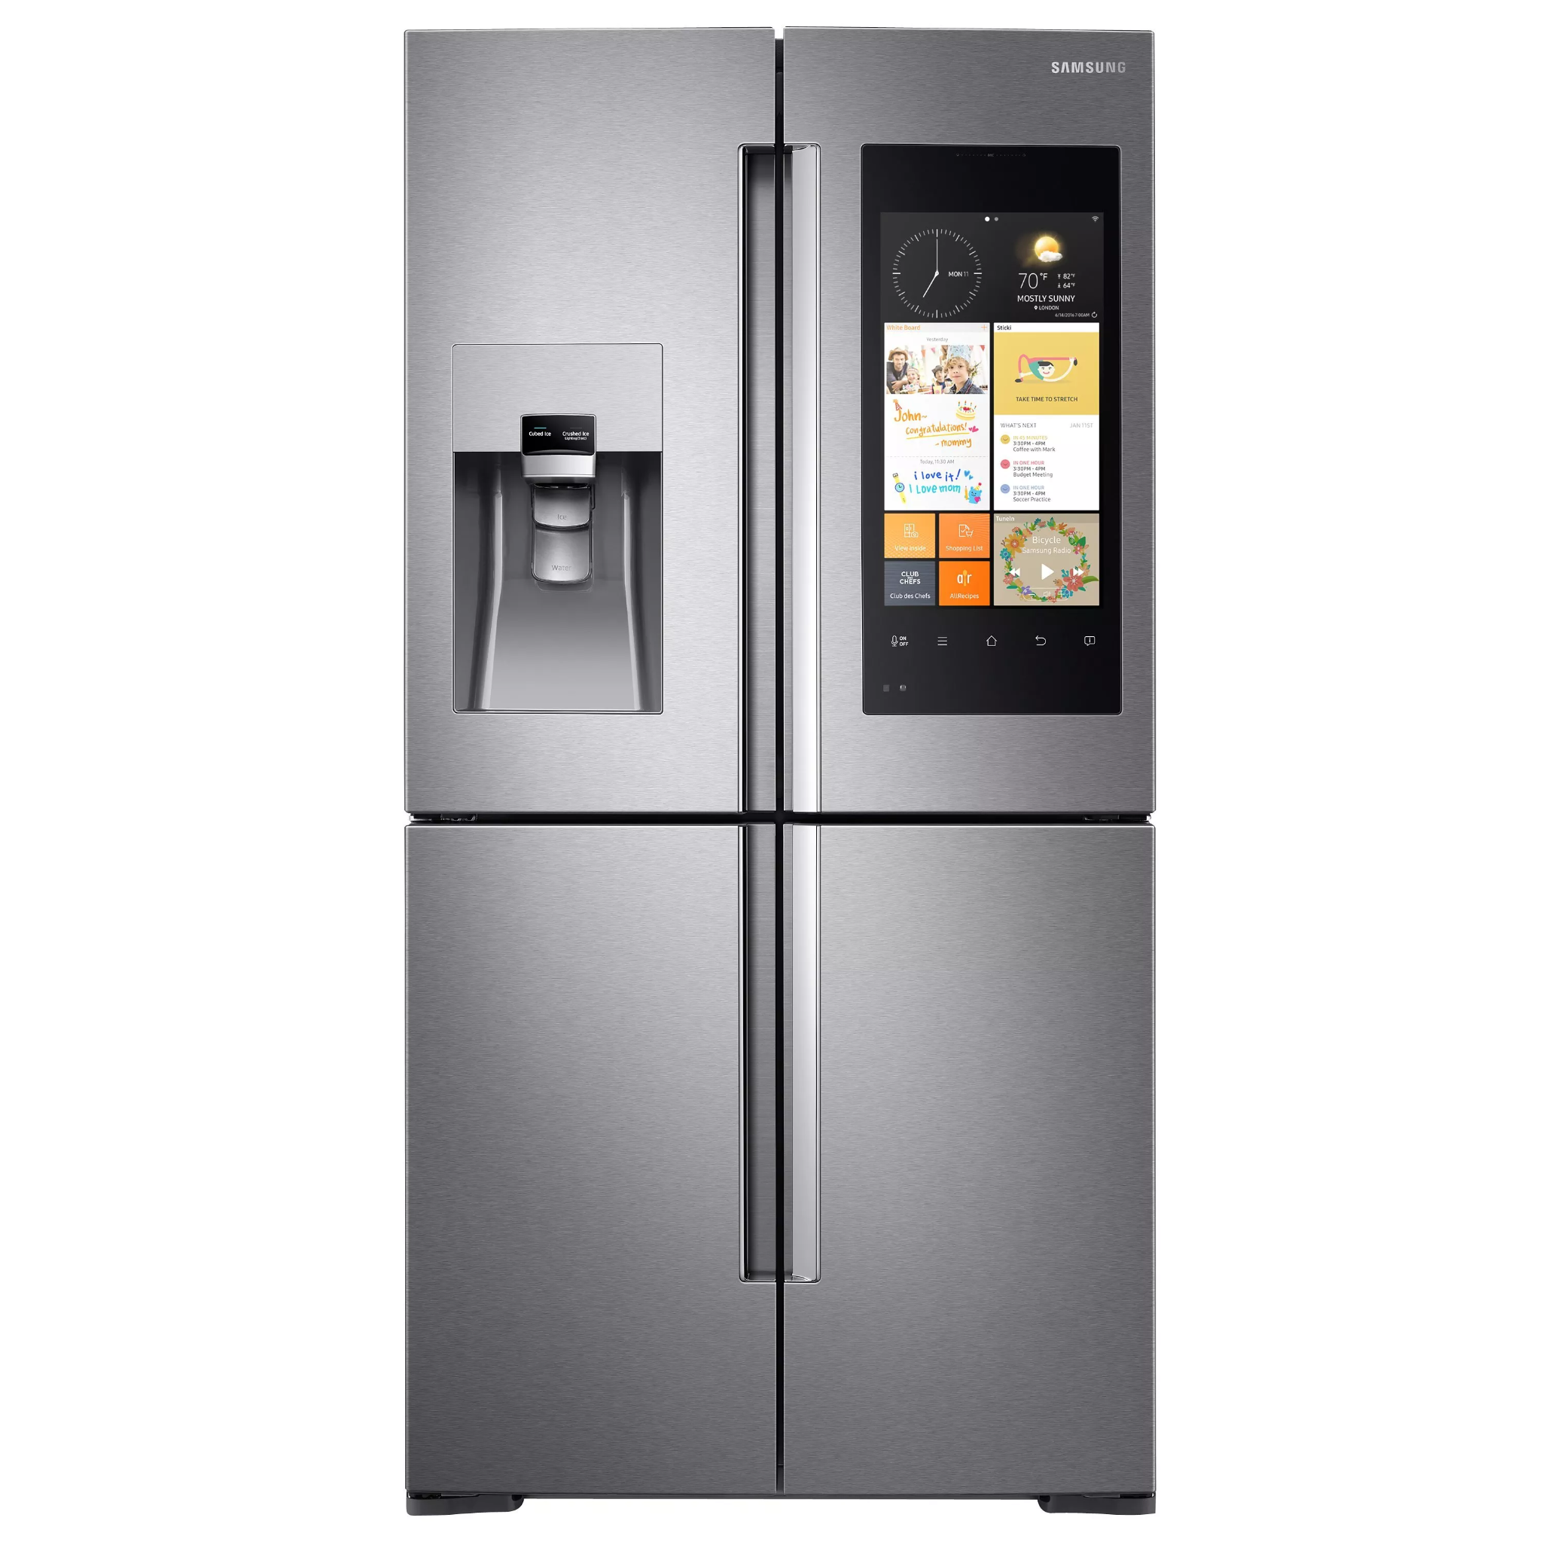
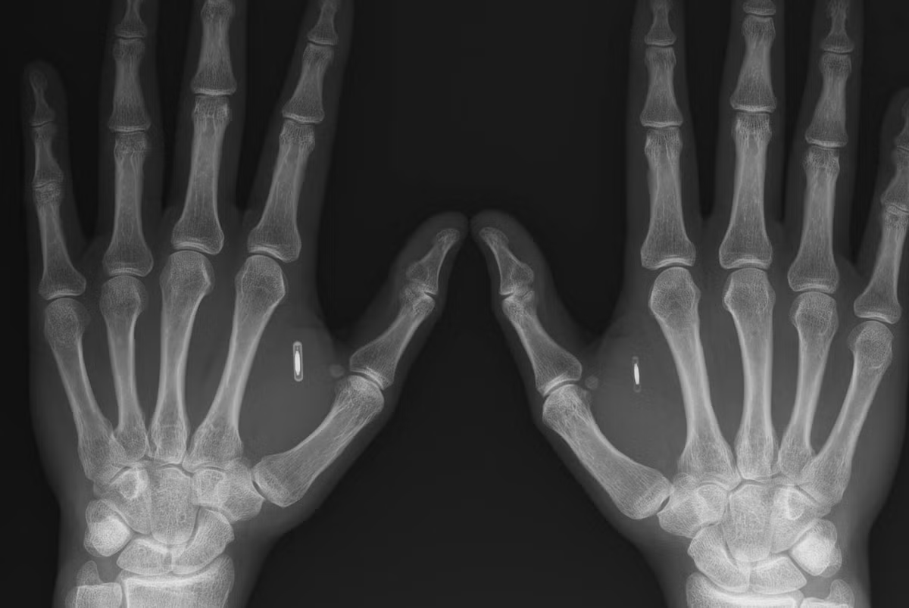
Sam Coward
Computer Chips

Slide 6
Ralph Sarkis
Is not as bothered by computer chips…

Slide 7

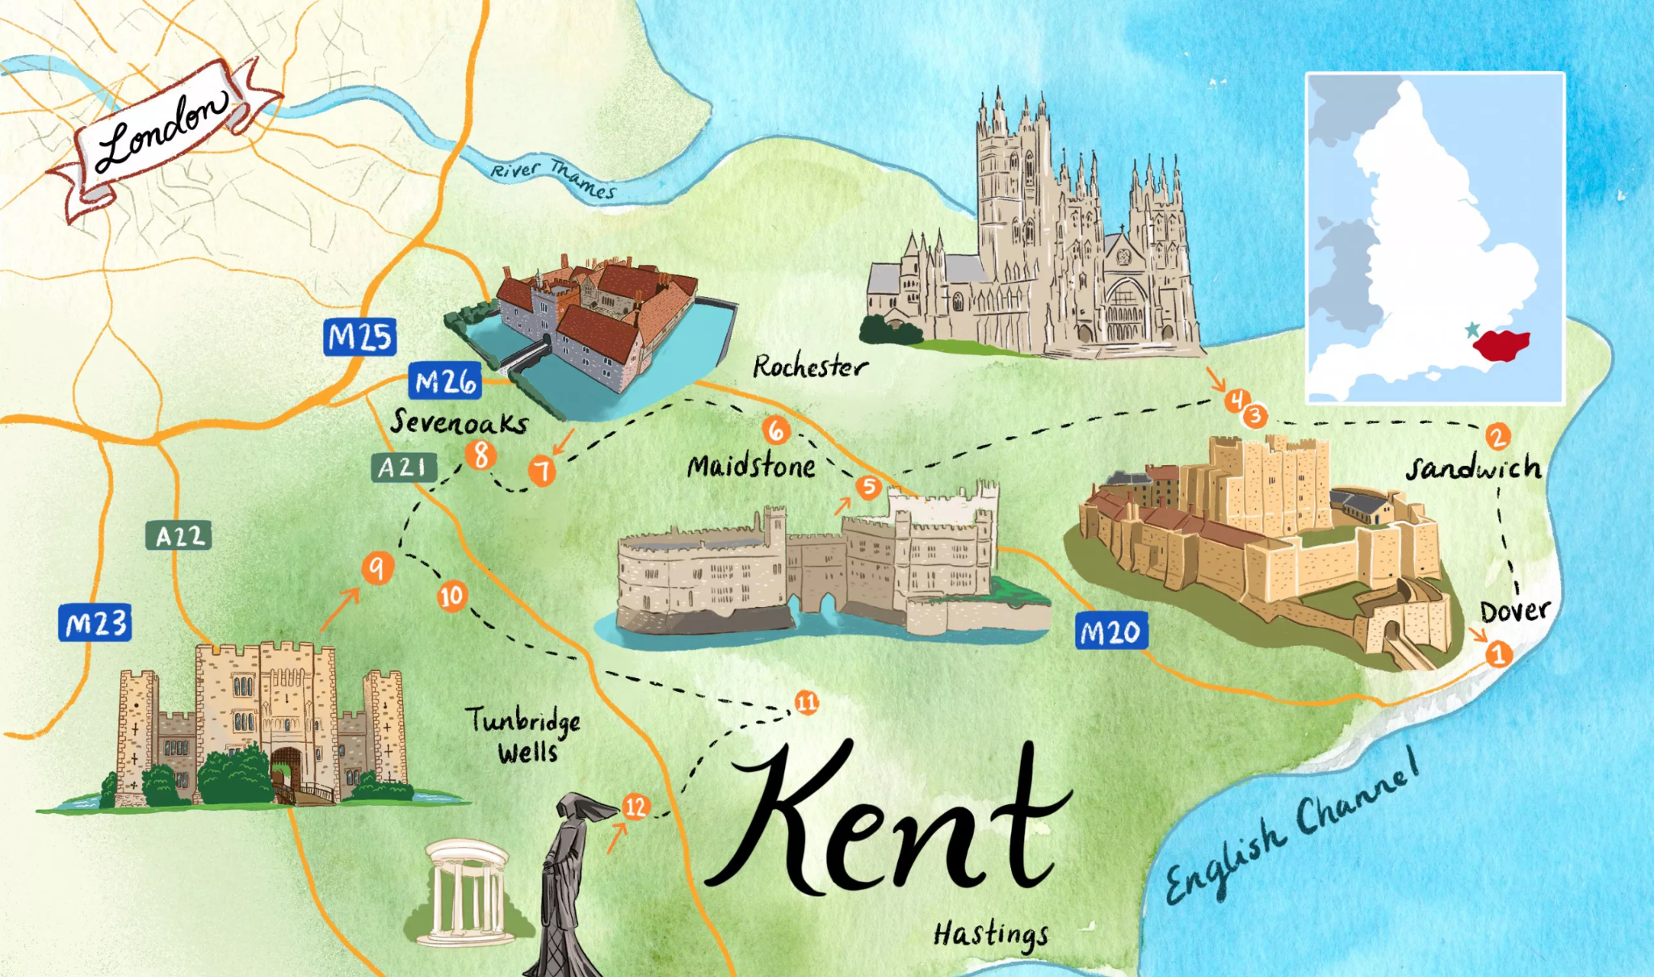
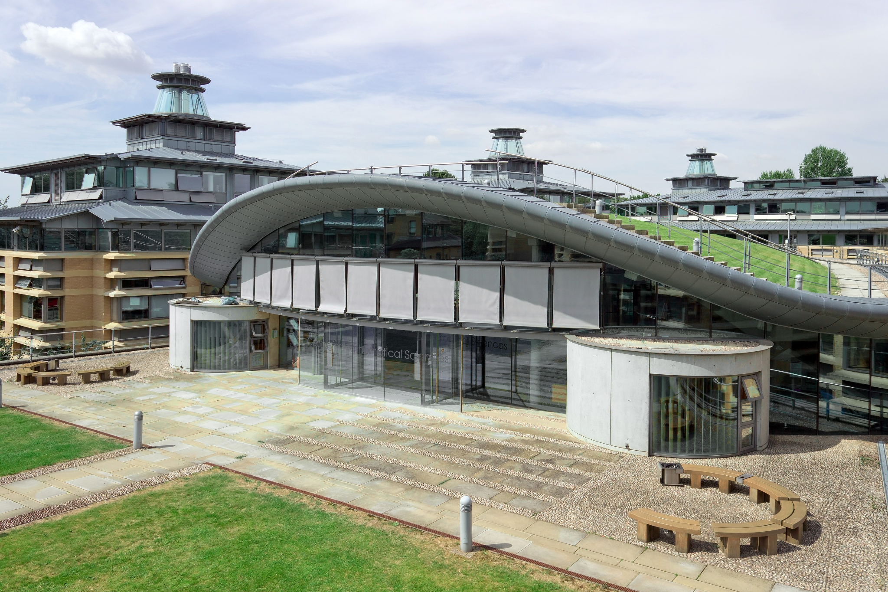




How did I get into computer chips?
Maths + Economics
More Maths
I did not plan my career!
Internships/Work Experience are great
It has been a random path…
Internships & Jobs!

Slide 8

Today…
Research Fellow
New ways to make computer chips faster, cheaper and more efficient!

Slide 9
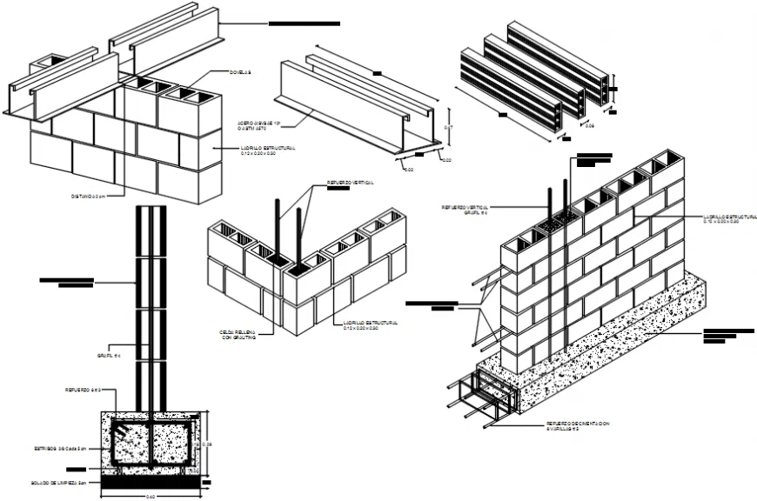

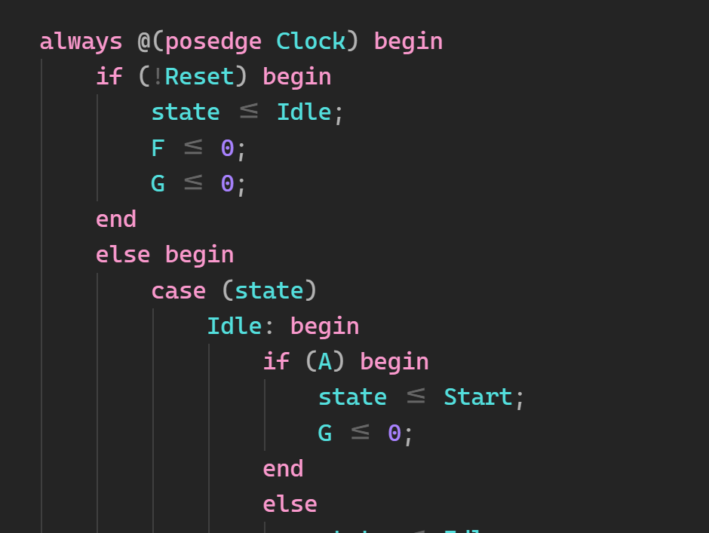
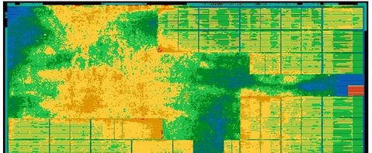
My Research
Architect’s Drawing
Bricks (10,000)
Code
Transistors (1 Billion)

Slide 10
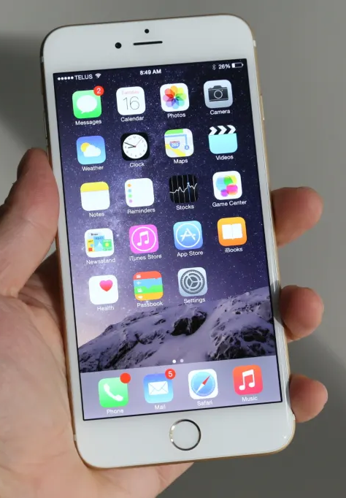

Quiz
Best selling phone ever?
iPhone 6 (left-hand) vs Nokia 1100 (right-hand)
❌
🏆
220 Million
250 Million

Slide 11

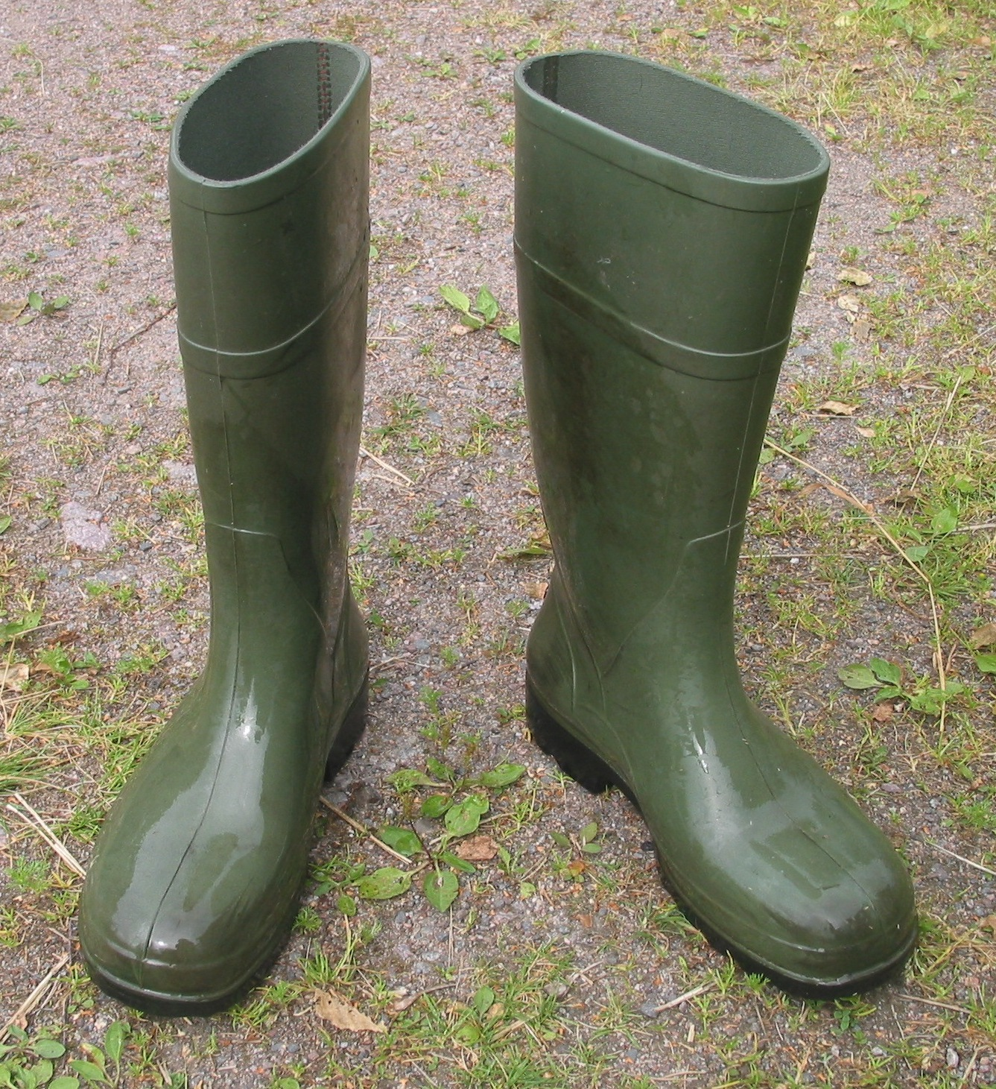
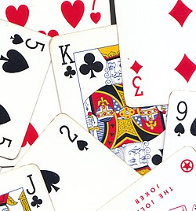
Quiz
2. What did Nintendo make originally?
Playing cards (left-hand) vs Welly Boots (right-hand)
🏆
❌

Slide 12
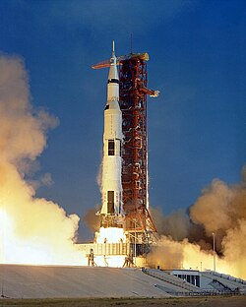
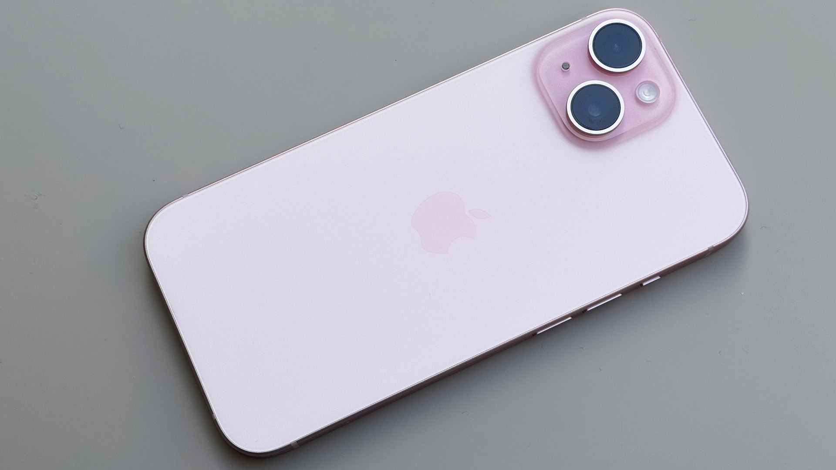
Quiz
3. What has more computing power?
iPhone 15 (left-hand) vs Apollo 11 Computer (right-hand)
🏆
❌

Slide 13
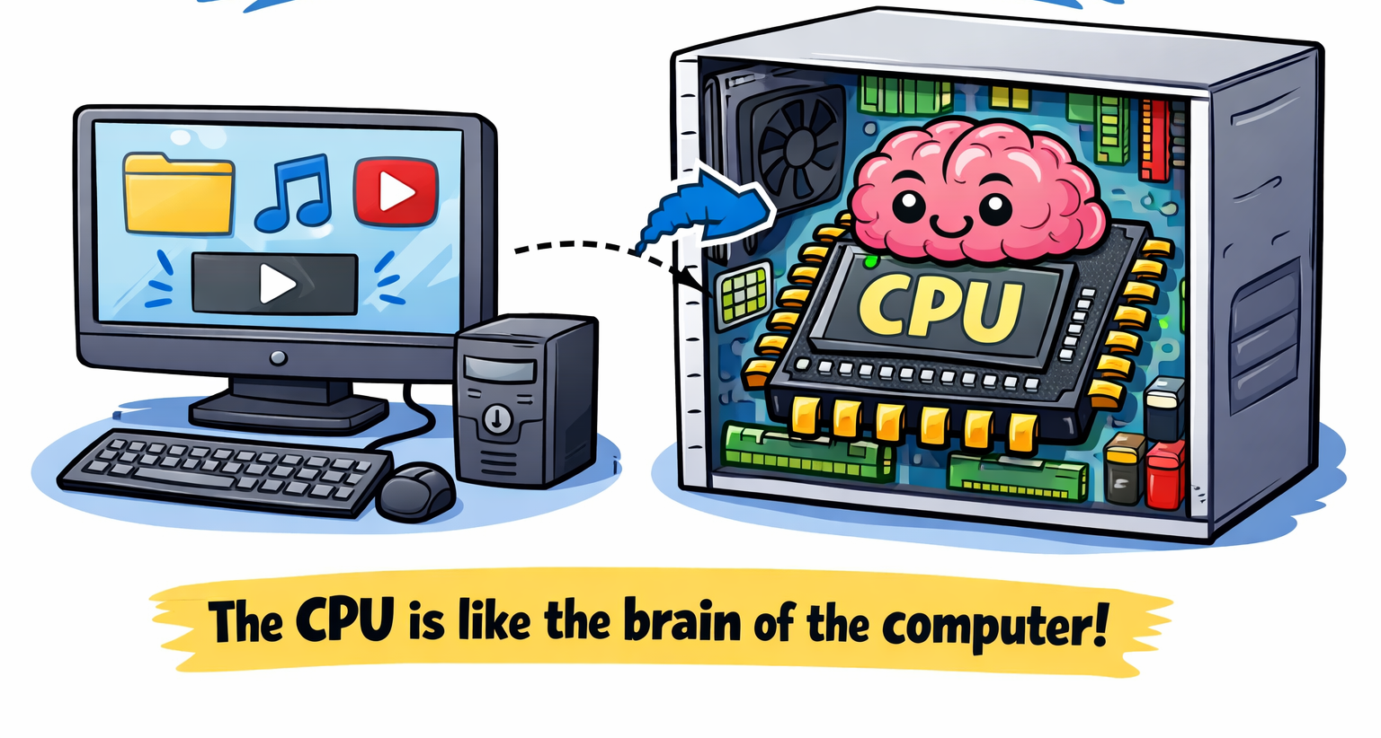
How do computers work?
CPU = Central Processing Unit
Each time you click, type or switch on your computer…
You give instructions to the CPU

Slide 14
CPUs are actually not that clever…
I am a CPU - please instruct me how to pick up that bottle?

Slide 15

Why should you care?
Computer chips will control the world you live in
Who controls their production?
Who decides what technology can do?
What problems do we (or don’t we) solve?
Careers:
People making computer chips get paid very well!!

Slide 16
CPUs do one instruction, then the next, then …
tick
tock

Slide 17
CPUs do one instruction, then the next, then …
CPU
Instructions:
ADD 4 5
SUB 7 7
MUL 9 3
tick

Slide 18
CPUs do one instruction, then the next, then …
CPU
ADD 4 5
Instructions:
SUB 7 7
MUL 9 3
tock

Slide 19
CPUs do one instruction, then the next, then …
CPU
Instructions:
SUB 7 7
MUL 9 3
tick
9

Slide 20
CPUs do one instruction, then the next, then …
CPU
SUB 7 7
Instructions:
MUL 9 3
tock
9

Slide 21
CPUs do one instruction, then the next, then …
CPU
Instructions:
MUL 9 3
tick
0
9

Slide 22
CPUs do one instruction, then the next, then …
CPU
MUL 9 3
Instructions:
tock
0
9

Slide 23
CPUs do one instruction, then the next, then …
CPU
Instructions:
tick
27
0
9

Slide 24
Any questions?

Slide 25






Group Activity
Form teams of 5 people

Slide 26
Each group will have
How
Goal
Scoring
Water bottle(s)
1 funnel
1 pad of sticky notes
Nominate team member(s) (CPU)
Team writes one instruction per cycle
CPU starts one instruction per cycle
Produce a bottle of salty squash
Salinity = how much salt
Colour = how much squash
squash rank
salinity rank
time-over optimal

Slide 27
Instruction | Cycles | Crash if
Collect ??g salt (maximum 10g) | 2
Collect ??ml squash (maximum 25ml) | 2
Remove bottle lid | 1 | Lid off
Replace bottle lid | 1 | Lid on
Add squash | 1 | Lid on
Add salt | 1 | Lid on
Shake bottle | 2 | Lid off
Test colour | 2 | Lid off
Test salinity | 2 | Lid off
Submit | 1 | Lid off

Slide 28
Demonstration

Slide 29
Round 1 - 1 Bottle - Easy Mode
Each Group: 1 CPU, 4 schedulers
Schedulers team write one instruction per cycle.
CPU executes a single instruction at a time (may take several cycles)
Must submit in less than 30 cycles
5
10
15
20
25
30
4
9
14
19
24
29
3
8
13
18
23
28
2
7
12
17
22
27
1
6
11
16
21
26

Slide 30
Judging & Solution
Reflections
 | 1 | 2 | 3 | 4 | 5 | 6 | 7 | 8 | 9 | 10 | 11
CPU | 7ml squash |  | 10g salt |  | Lid Off | Add Squash | Add Salt | Lid On | Shake |  | Submit
What was challenging?
How could you improve the results?

Slide 31
Round 2 - 2 Bottles - Parallel Execution
Each Group: 2 CPUs, 3 schedulers
Schedulers team write one instruction per cycle.
CPU executes a single instruction at a time (may take several cycles)
Must submit in less than 30 cycles
5
10
15
20
25
30
4
9
14
19
24
29
3
8
13
18
23
28
2
7
12
17
22
27
1
6
11
16
21
26

Slide 32
Judging & Solution
 | 1 | 2 | 3 | 4 | 5 | 6 | 7 | 8 | 9 | 10 | 11
CPU 1 | 7ml squash |  | 10g salt |  | Lid Off | 🕔 | Add Squash | Add Salt | Lid On | Shake
CPU 2 | 🕔 | 25ml squash |  | 25ml squash |  | 3g salt |  | 🕔 | 🕔 | 🕔 | Lid Off
 | 12 | 13 | 14 | 15 | 16 | 17
CPU 1 | 🕔 | 🕔 | 🕔 | 🕔 | Submit | 🕔
CPU 2 | Add Squash | Add Salt | Lid On | Shake |  | Submit

Slide 33
Round 3 - 1 Bottle
Each Group: 1 CPU, 4 schedulers
Schedulers team write instructions ahead of time and number them! (15 mins)
New Instruction:
if (salt/squash too low) then goto instruction ?? else continue
Scoring Update:
squash rank
3 x salinity rank
time-over optimal

Slide 34
New Instruction Example
Collect 5g salt
Lid Off
Add Salt
Lid On
Shake
Test salinity
If (salt too low) then goto 1 else continue
Collect 5ml squash
…

Slide 35
Instruction | Cycles | Crash if
Collect ??g salt (maximum 10g) | 2
Collect ??ml squash (maximum 25ml) | 2
Remove bottle lid | 1 | Lid off
Replace bottle lid | 1 | Lid on
Add squash | 1 | Lid on
Add salt | 1 | Lid on
Shake bottle | 2 | Lid off
Test colour | 2 | Lid off
Test salinity | 2 | Lid off
If ?? then goto ?? else continue
Submit | 1 | Lid off

Slide 36
Round 4 - 1 Bottle - Compilation
Each Group: 1 CPU, 4 schedulers
Schedulers team write instructions ahead of time and number them! (15 mins)
CPU executes a single instruction at a time (may take several cycles)
Must submit in less than 30 cycles
5
10
15
20
25
30
4
9
14
19
24
29
3
8
13
18
23
28
2
7
12
17
22
27
1
6
11
16
21
26

Slide 37
Judging & Solution
 | 1 | 2 | 3 | 4 | 5 | 6 | 7 | 8 | 9 | 10
CPU | 15ml squash |  | 10g salt |  | 10g salt |  | Lid Off | Add Salt | Add Squash | Lid On
 | 11 | 12 | 13
CPU | Shake |  | Submit

Slide 38
Overall Winning Corporation
Round 1:
Round 2:
Round 3:

Slide 39
Wrap Up
CPUs are the brains of a computer
Round 1 Scheduling: CPUs execute tiny instructions
Round 2 Parallel: Modern CPUs actually have many little CPUs (cores)
Round 3 Compilers: determine the instructions ahead of time
🙍
🙍
🙍
🖹
Round 1
🧠
🧠🧠
🧠
Round 2
Round 3

Slide 40
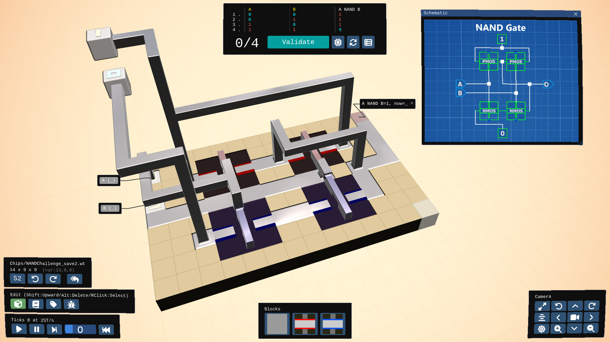
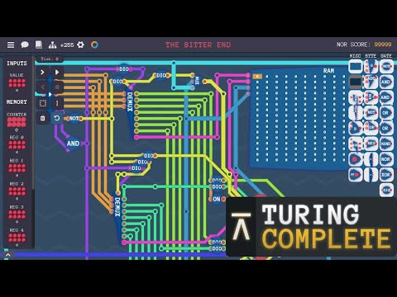
To Learn More
Games: Hard Chip, Turing Complete
YouTube: ComputerPhile
Reading: Chip Wars
Degrees: Electrical Engineering, Computer Science

